Slide 1
Panopticism and Totalitarian Space: An Exploration of Power Dynamics in Satyajit Ray’s film
Hirak Rajar Deshe
Author
Nadia Shahid Diba
Reg. No: 2019236040
Session: 2019-20

Slide 2

Overview of Hirak Rajar Deshe
Released in 1980 as a sequel of Goopy Gyne Bagha Byne .
Stands as an allegory of power and oppression.
Set in a fictional kingdom ruled by the tyrannical Hirak Raja.
Reflects on authority, freedom, and resistance.

Slide 3
Examine the power dynamics in Hirak Rajar Deshe using Michel Foucault's theory of panopticism.
Investigate the use of surveillance, technology and control as tools of oppression to create a totalitarian space.
Explore how the film critiques the suppression of individual freedoms under authoritarian rule.
Highlight the depiction of resistance within a totalitarian power structure.
Objectives

Slide 4
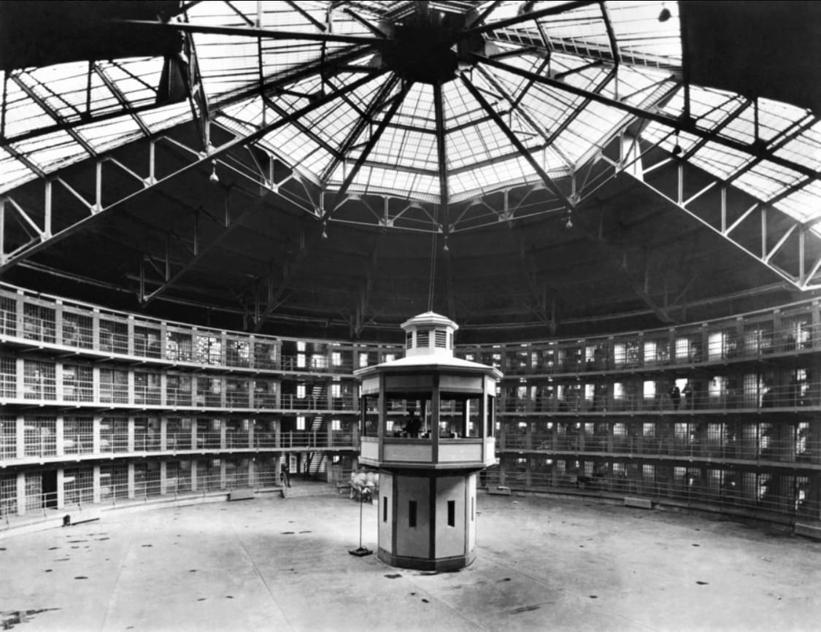

Theoretical Framework
Michel Foucault's Panopticism
Derived from Bentham's Panopticon, a prison design for control through invisible surveillance.
Refers to exerting power through constant observation
Leads to psychological Self-Surveillance
Totalitarianism
A form of government controlling both public and private life.
Hannah Arendt describes it as the destruction of spontaneity and resistance.

Slide 5
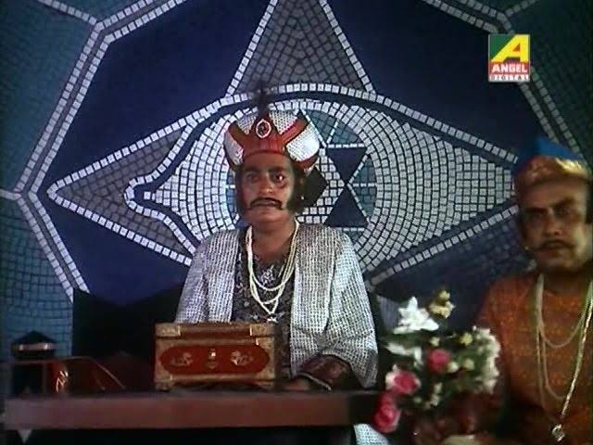
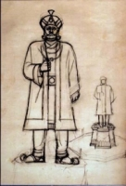
Surveillance and Psychological Control
The Silent Weapon of the oppressive King
Use of Brainwashing Machine to enforce conformity.
"Even if you die in the process, King of Hirak is God no less" (Hirak Rajar Deshe, 00:27:18-00:27:25)
Symbols of ever-present surveillance: Advance tools like Binocular and the Eye-Sign behind the throne.
His “Yes-Sir” advisors’ self-regulation out of fear.
King's statue in the middle of the kingdom : A watcher.

Slide 6

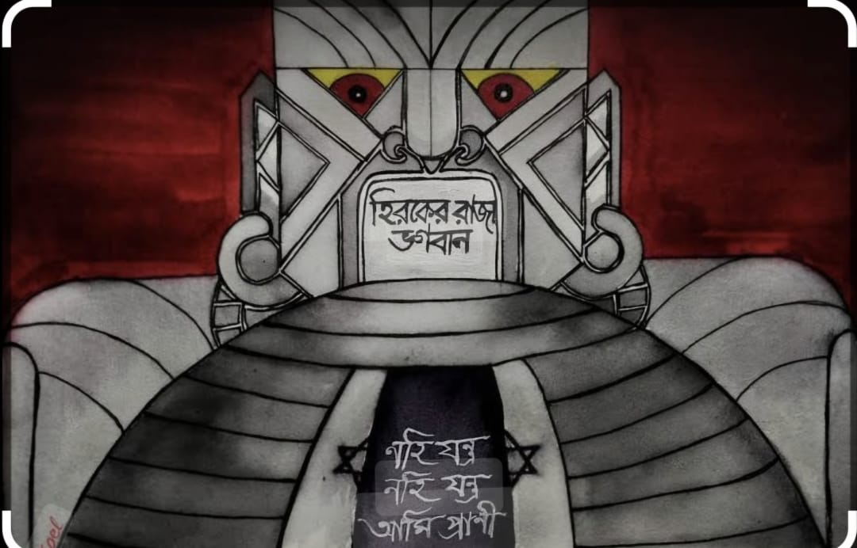
The Dystopian Kingdom
(Totalitarian Space)
Mirrors a dystopian space where thought control is more effective than violence.
"Learning is a waste/ The more they study, the lesser they follow rules"(Hirak Rajar Deshe, 00:21:37-00:21:48) -Banning education to suppress alternative thinking.
"Even if you don't eat food, taxes you must make good“ (00:27:18-00:27:25) -Forced labor and Economic oppression.

Slide 7

Resistance
A Glimmer of Hope
In a world of constant surveillance and control, can anyone resist?
Udayan Pandit challenges the king through education.
Goopy and Bagha’s use of magic to outsmart the king’s control.

Slide 8
Conclusion
Hirak Rajar Deshe is a bold critique of how power can be sustained through surveillance and psychological control.
Ray shows us that even in the darkest space, resistance is always possible.
The film's legacy: A cautionary narrative for our increasingly watched world.

Slide 9
Works Cited
Ahmed, Saladdin. “Panopticism and Totalitarian Space.” Theory in Actio, vol. 11, no. 1, 2018, pp. 1–16, philpapers.org/rec/AHMPAT-2. Accessed 1 May 2024.
---. Totalitarian Space and the Destruction of Aura. PhilPapers, Albany, NY, USA, SUNY Press, 2019, pp. 1–50, philpapers.org/rec/AHMTSA-2. Accessed 1 May 2024.
Arendt, Hannah. The Origins of Totalitarianism. United States, Franklin Classics, 2019, pp. 300–350.
Bentham, Jeremy. The Panopticon Writings. London, Verso, 1995, pp. 29–95.
Caluya, Gilbert. “The Post-Panoptic Society? Reassessing Foucault in Surveillance Studies.” Social Identities, vol. 16, no. 5, Sept. 2010, pp. 621–633, www.tandfonline.com/doi/full/10.1080/13504630.2010.509565, https://doi.org/10.1080/13504630.2010.509565.
Foucault, Michel. Discipline and Punish: The Birth of the Prison. New York, Vintage Books, 1975, pp. 195–230.
Hirak Rajar Deshe. Directed by Satyajit Ray, Government of West Bengal, 19 Dec. 1980.
Larsen, Neil. The Discourse of Power. Institute for the Study of Ideologies and Literature, Minneapolis, 1983, p. 2.
Misra, Amaresh. “Satyajit Ray’s Films: Precarious Social-Individual Balance.” Economic and Political Weekly, vol. 27, no. 20/21, 1992, pp. 1052–1054, www.jstor.org/stable/4397887. Accessed 1 May 2024.
Smart, Barry. Michel Foucault. London ; New York, Routledge, 2002, pp. 70–80.

Slide 10
THANK YOU

